Slide 1




Trees and Tree-Like Structures
Trees, Tree-Like Structures, Binary Search Trees, Balanced Trees, Implementations
Tree-Like Structures
SoftUni Team
Technical Trainers
Software University
http://softuni.bg

Slide 2
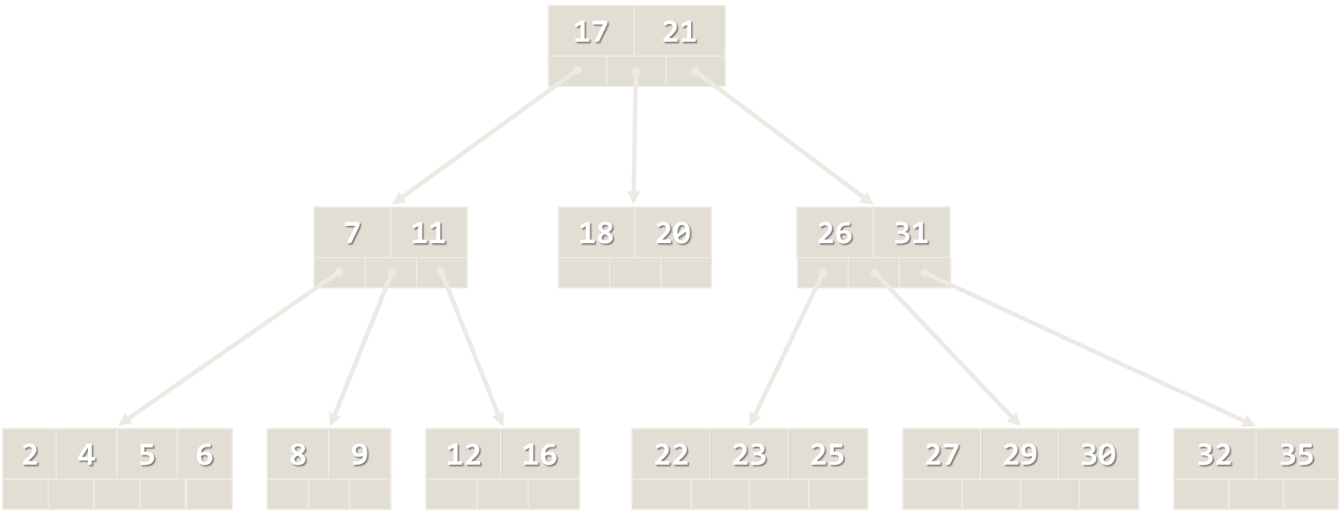

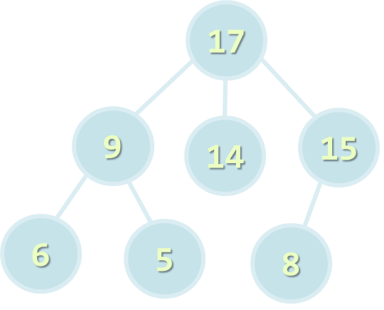
Table of Contents
Tree-like Data Structures
Trees and Related Terminology
Implementing Trees
Binary Trees and Traversals
Pre-order (node, left, right)
In-order (left, node, right)
Post-order (left, right, node)
Balanced Search Trees
Graphs

Slide 3
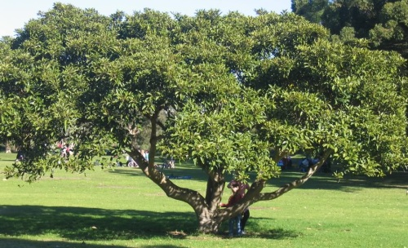
Tree-like Data Structures
7
1
14
21
19
31
Trees, Balanced Trees, Graphs, Networks

Slide 4
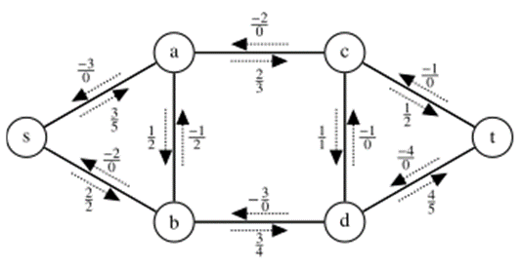

Tree-like Data Structures
Tree-like data structures are:
Branched recursive data structures
Consisting of nodes
Each node connected to other nodes
Examples of tree-like structures
Trees: binary, balanced, ordered, etc.
Graphs: directed / undirected, weighted, etc.
Networks: graphs with multiple relations between nodes

Slide 5
Tree-like Data Structures
5 (20)
2
Network
1
5 (10)
Tree
10 (40)
Project Manager
20(20)
6
15 (15)
3
15 (30)
5 (5)
Team Leader
Designer
QA Team Leader
4
5
Developer 1
Developer 3
Tester 1
Tester 2
7
1
Developer 2
14
Graph
4
21
11
12
19
31

Slide 6

Trees and Related Terminology
Project Manager
Team Leader
Designer
QA Team Leader
Node, Edge, Root, Children, Parent, Leaf, Binary Search Tree, Balanced Tree

Slide 7
Tree Data Structure – Terminology
Node, edge, root, child, children, siblings, parent, ancestor, descendant, predecessor, successor, internal node, leaf, depth, height, subtree
17
Depth 0
9
14
15
Depth 1
Height = 3
6
5
8
Depth 2

Slide 8
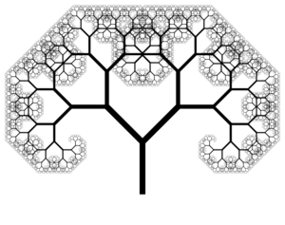
Implementing Trees
Recursive Tree Data Structure

Slide 9
Recursive Tree Definition
The recursive definition for tree data structure:
A single node is tree
Tree nodes can have zero or multiple children that are also trees
Tree node definition in C#
The value stored in the node
public class Tree<T>
{
private T value;
private IList<Tree<T>> children;
…
}
List of child nodes, which are of the same type

Slide 10
Tree<int> Structure – Example
IList<Tree<int>> children
int value
7
children
Tree<int>
19
children
21
children
14
children
1
children
31
children
23
children
6
children
12
children

Slide 11

Implementing Tree<T>
public class Tree<T>
{
public T Value { get; set; }
public IList<Tree<T>> Children { get; private set; }
public Tree(T value, params Tree<T>[] children)
{
this.Value = value;
this.Children = new List<Tree<T>>();
foreach (var child in children)
{
this.Children.Add(child);
}
}
}
Flexible constructor for building trees

Slide 12
Building a Tree
Constructing a tree by nested constructors:
Tree<int> tree =
new Tree<int>(7,
new Tree<int>(19,
new Tree<int>(1),
new Tree<int>(12),
new Tree<int>(31)),
new Tree<int>(21),
new Tree<int>(14,
new Tree<int>(23),
new Tree<int>(6))
);
7
19
21
14
1
12
31
23
6

Slide 13
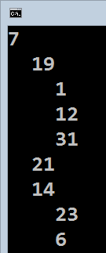
Printing a Tree
Printing a tree at the console – recursive algorithm
public class Tree<T>
{
…
public void Print(int indent = 0)
{
Console.Write(new string(' ', 2 * indent));
Console.WriteLine(this.Value);
foreach (var child in this.Children)
child.Print(indent + 1);
}
}

Slide 14
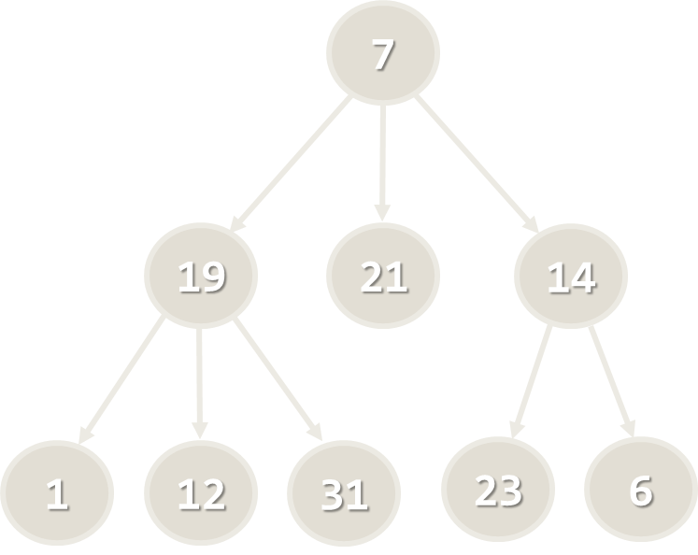
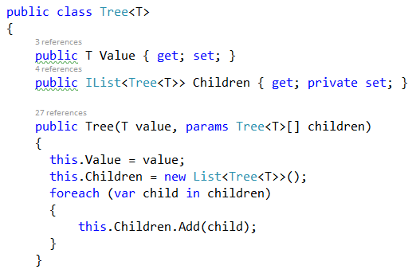
Lab Exercise
Trees and Trees Traversal

Slide 15
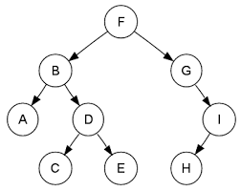
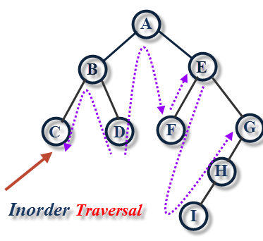
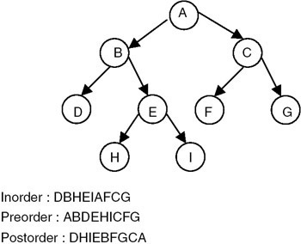
Binary Trees and Traversals
Preorder, In-Order, Post-Order

Slide 16
Binary Trees
Binary trees: the most widespread form
Each node has at most 2 children (left and right)
Root node
17
Right child
Left
subtree
9
15
Right child
6
5
8
10
Left child

Slide 17
Binary Trees Traversal
Binary trees can be traversed in 3 ways:
Pre-order: root, left, right
In-order: left, root, child
Post-order: left, right, root
Example:
Arithmetic expression stored as binary tree: (3 + 2) * (9 - 6)
*
+
-
3
2
9
6
Pre-order: * + 3 2 - 9 6
In-order: 3 + 2 * 9 - 6
Post-order: 3 2 + 9 6 - *

Slide 18
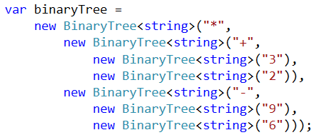
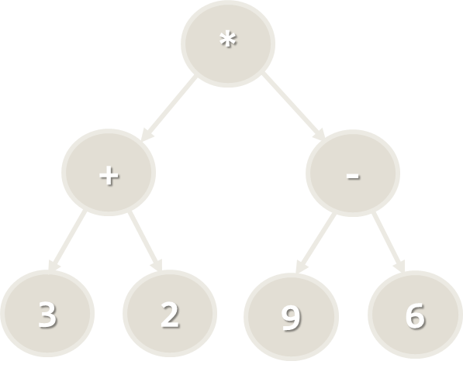
Lab Exercise
Binary Trees and Traversal

Slide 19

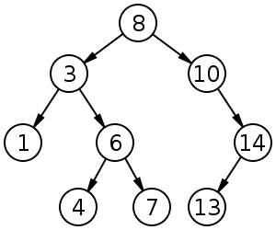
Binary Search Trees
Binary search trees are ordered
For each node x in the tree
All the elements in the left subtree of x are ≤ x
All the elements in the right subtree of x are > x
Binary search trees can be balanced
Balanced trees have for each node
Nearly equal number of nodes in its subtrees
Balanced trees have height of ~ log(x)

Slide 20
Binary Search Trees (2)
Example of balanced binary search tree
If the tree is balanced, add / search / delete operations take approximately log(n) steps
17
9
19
6
12
25

Slide 21


Balanced Search Trees
AVL Trees, B-Trees, Red-Black Trees, AA-Trees

Slide 22
Balanced Binary Search Trees
Ordered Binary Trees (Binary Search Trees)
For each node x the left subtree has values ≤ x and the right subtree has values > x
Balanced Trees
For each node its subtrees contain nearly equal number of nodes → nearly the same height
Balanced Binary Search Trees
Ordered binary search trees that have height of log₂(n) where n is the number of their nodes
Searching costs about log₂(n) comparisons

Slide 23
Balanced Binary Search Tree – Example
The left subtree has 7 nodes
33
The right subtree has 7 nodes
18
54
15
24
42
60
3
17
20
29
37
43
85

Slide 24
Balanced Binary Search Trees
Balanced binary search trees are hard to implement
Rebalancing the tree after insert / delete is complex
Rotations change the structure without interfering the nodes order
Well known implementations of balanced binary search trees
AVL Trees – ideally balanced, very complex
Red-black Trees – roughly balanced, more simple
AA-Trees – relatively simple to implement
Find / insert / delete operations need log(n) steps

Slide 25
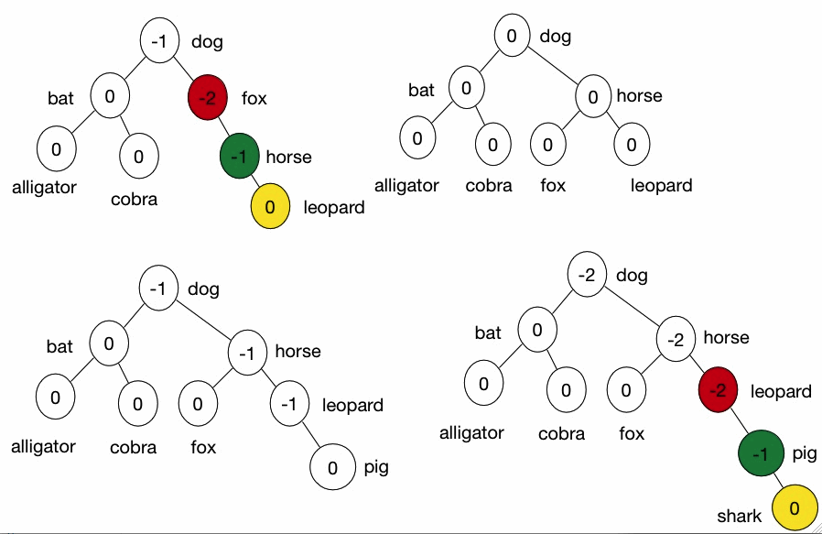
AVL Tree – Example
AVL tree (Adelson-Velskii and Landis)
Self-balancing binary-search tree (see the visualization)

Slide 26
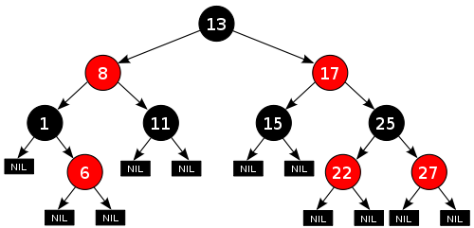
Red-Black Tree – Example
Red-Black tree – binary search tree with red and black nodes
Not perfectly balanced, but has height of O(log(n))
Used in C# and Java
See the visualization
AVL vs. Red-Black
AVL has faster search (it is better balanced)
Red-Black has faster insert / delete

Slide 27
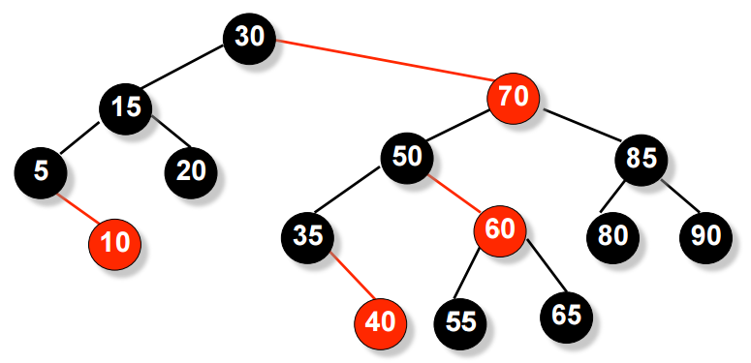
AA Tree – Example
AA tree (Arne Andersson)
Simple self-balancing binary-search tree
Simplified Red-Black tree
Easier to implement than AVL and Red-Black
Some Red-Black rotations are not needed

Slide 28
B-Trees
B-trees are generalization of the concept of ordered binary search trees – see the visualization
B-tree of order b has between b and 2*b keys in a node and between b+1 and 2*b+1 child nodes
The keys in each node are ordered increasingly
All keys in a child node have values between their left and right parent keys
If the B-tree is balanced, its search / insert / add operations take about log(n) steps
B-trees can be efficiently stored on the disk

Slide 29
B-Tree – Example
B-Tree of order 2 (also known as 2-3-4-tree):
17
21
7
11
18
20
26
31
4
5
6
8
9
12
16
22
23
25
27
29
30
32
35

Slide 30
Balanced Search Trees
AVL Trees, B-Trees, Red-Black Trees, AA-Trees

Slide 31
Balanced Trees in .NET
.NET Framework has several built-in implementations of balanced search trees:
SortedDictionary<K, V>
Red-black tree based dictionary (map) of key-value pairs
SortedSet<T>
Red-black tree based set of elements
External libraries like "Wintellect Power Collections for .NET" are more flexible
http://powercollections.codeplex.com

Slide 32
OrderedSet<T>: Red-Black Tree in .NET
In .NET Framework OrderedSet<T> is based on red-black tree
Holds an ordered set of non-repeating elements
Insert / delete / find / subset has O(log(n)) running time
var set = new SortedSet<int>();
set.Add(5); // 5
set.Add(8); // 5, 8
set.Add(-2); // -2, 5, 8
set.Add(30); // -2, 5, 8, 30
set.Add(20); // -2, 5, 8, 20, 30
var subset = set.GetViewBetween(5, 20);
subset.ToList().ForEach(Console.WriteLine); // 5, 8, 20

Slide 33
Graphs
7
1
14
4
21
11
12
19
31
Set of Nodes Connected with Edges

Slide 34
Graph Data Structure
Graph (denoted as G(V, E))
Set of nodes V with many-to-many relationship between them (edges E)
Each node (vertex) has multiple predecessors and multiple successors
Edges connect two nodes (vertices)
Node with multiple successors
Edge
Node with multiple predecessors
7
1
14
4
21
11
Self-relationship
Node
12
19
31

Slide 35
Graph Definitions
Node (vertex)
Element of graph
Can have name or value
Keeps a list of adjacent nodes
Edge
Connection between two nodes
Can be directed / undirected
Can be weighted / unweighted
Can have name / value
Node
A
Edge
A
B

Slide 36
Graph Definitions (2)
Directed graph
Edges have direction
Undirected graph
Edges have no direction
22
2
3
A
F
7
J
1
4
D
G
21
12
E
C
H
19
3

Slide 37
Graph Definitions (3)
Weighted graph
Weight (cost) is associated with each edge:
10
A
F
4
5
N
J
6
16
8
Q
D
7
22
G
9
3
14
K
E
C
H

Slide 38
Graphs – Implementation
public class Graph
{
List<int>[] childNodes;
public Graph(List<int>[] nodes)
{
this.childNodes = nodes;
}
}
Typically graphs are stored as lists of descendant nodes
Instead of nodes, usually their index (number) is stored
Graph g = new Graph(new List<int>[] {
new List<int> {3, 6}, // successors of vertex 0
new List<int> {2, 3, 4, 5, 6},// successors of vertex 1
new List<int> {1, 4, 5}, // successors of vertex 2
new List<int> {0, 1, 5}, // successors of vertex 3
new List<int> {1, 2, 6}, // successors of vertex 4
new List<int> {1, 2, 3}, // successors of vertex 5
new List<int> {0, 1, 4} // successors of vertex 6
});
0
6
3
1
4
5
2

Slide 39
Summary
Trees are recursive data structures
A tree is a node holding a set of children (which are also nodes)
Binary search trees are ordered binary trees
Balanced trees have weight of log(n)
AVL trees, Red-Black trees and AA trees are self-balancing binary search trees, used to implement ordered sets, bags and dictionaries
Graph == set of nodes with many-to-many relationships
Can be directed / undirected, weighted / unweighted, connected / not connected, etc.

Slide 40









Trees and Tree-Like Structures
https://softuni.bg/trainings/1147/Data-Structures-June-2015

Slide 41
License
This course (slides, examples, labs, videos, homework, etc.) is licensed under the "Creative Commons Attribution-NonCommercial-ShareAlike 4.0 International" license
Attribution: this work may contain portions from
"Fundamentals of Computer Programming with C#" book by Svetlin Nakov & Co. under CC-BY-SA license
"Data Structures and Algorithms" course by Telerik Academy under CC-BY-NC-SA license

Slide 42





Free Trainings @ Software University
Software University Foundation – softuni.org
Software University – High-Quality Education, Profession and Job for Software Developers
softuni.bg
Software University @ Facebook
facebook.com/SoftwareUniversity
Software University @ YouTube
youtube.com/SoftwareUniversity
Software University Forums – forum.softuni.bg

